Slide 1
Developing chat bot using Microsoft Bot Framework
Wenhao Huang (黄文灏)
Microsoft Research Asia
Big Data Mining Group
2017-05-19
Notes:
大家好，我是黄文灏，来自微软亚洲研究院，大数据挖掘组。
今天我为大家简单介绍一下如何使用微软Bot Framework开发自己的聊天机器人。

Slide 2
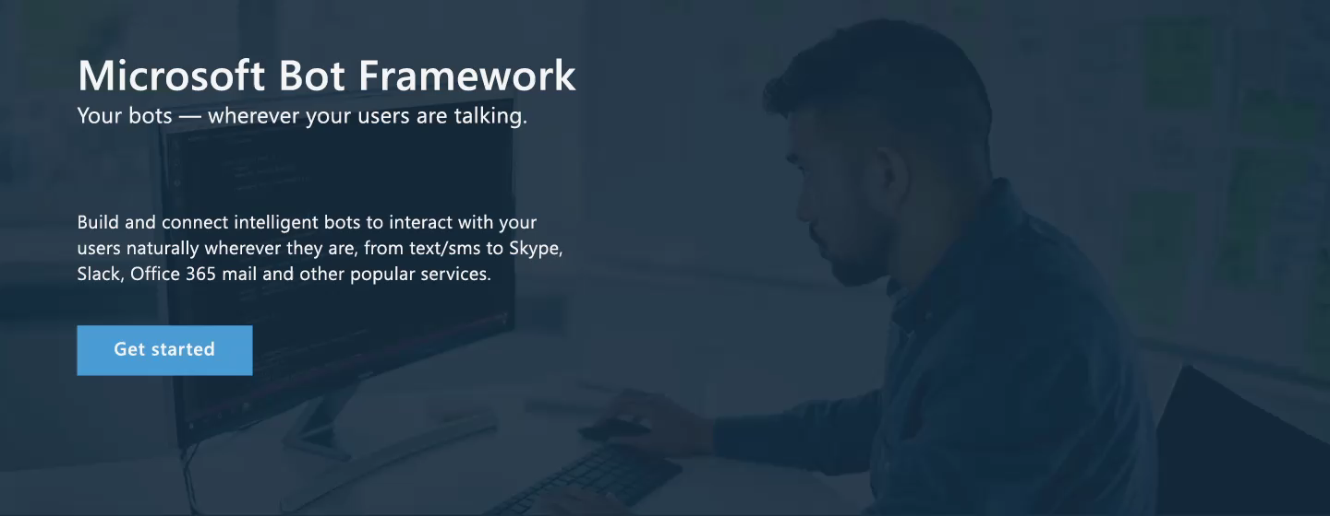
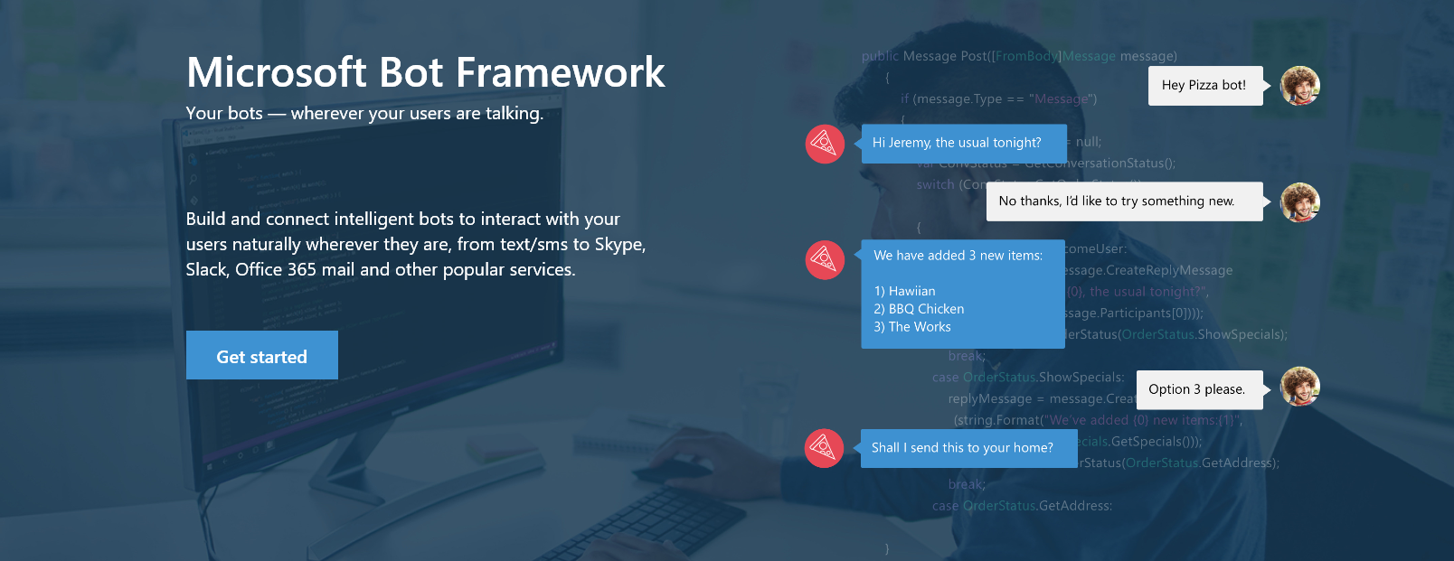

www.botframework.com
Notes:
微软Bot Framework是微软在去年的开发者大会build上正式推出的聊天机器人开发框架，是微软CaaP战略的重要组成部分。
它能帮助开发者快速有效地进行聊天机器人开发。

Slide 3

Bot Framework Components
Bot Connector
Bot Builder SDKs
Bot Directory
Connect your bot(s) to text/sms, Office 365 mail, Skype, Slack, and other services.
Build great dialogs within your Node.js- or C#-based bot
Try, use, and add published bots to the world’s top conversation experiences
Register, connect, publish and manage your bot through the bot dashboard
Message routing
Automatic translation to 30+ languages
User and state management
Embeddable web chat control
Debugging tools
Open source SDK on Github
From simple built-in prompts and command dialogs to simple to use yet sophisticated ‘FormFlow’ dialogs
Libraries, samples and tools to make a great conversationalist
Chat emulator
Leverage related services available in Cognitive Services
Public directory of bots registered and approved with Bot Framework
Users can try your bot from the directory via the web chat control
Users can discover and add your bot to the channels on which it is configured
Notes:
Bot Framework有三个重要的组成部分。
第一部分为Bot Connector，它主要帮助开发者将聊天机器人的后端服务发布到各个不同的交流平台上，包括短信，邮件，Skype，Slack等。
开发者只需开发一个后端服务，就可以快速连接上不同的channel（交流平台），节省了大量通讯端的开发成本。
它可以连接的channel正在快速增多，相信很快国内常用的微信，微博都会登陆bot connector。
第二部分是Bot Builder。它是一套开源的SDK，可以快速生成聊天机器人后端开发模板，并且提供了开发聊天机器人常用的工具，帮助开发者更高效地开发自己的聊天机器人。
第三部分是Bot Directory，它是一个bot的商店，用户在其中看到并试用别人开发的Bot。

Slide 4
Get Started
Install prerequisite software
Visual Studio (latest update) - you can download the community version here for free: www.visualstudio.com
Important: Please update all VS extensions to their latest versions Tools->Extensions and Updates->Updates
Download and install the Bot Application template
Download the file from the direct download link here:
Save the zip file to your Visual Studio 2015 templates directory which is traditionally in "%USERPROFILE%\Documents\Visual Studio 2015\Templates\ProjectTemplates\Visual C#\"
Open Visual Studio
Create a new C# project using the new Bot Application template.
Notes:
今天的课程会以实际操作为主。
下面我简单介绍一下开发需要的环境准备和基本步骤。
然后就会通过几个实际的例子帮助大家快速上手bot framework。
今天的课程以c#作为开发语言讲解。使用其他开发语言的同学可以参阅bot framework的官方网站查看其他相对应的教程。
首先我们需要安装Visual Studio，这里提醒大家最好将visual studio升级到最新版本，这样可以使用一些比较高级的功能。
然后我们需要下载bot application的模板，下载链接可以在bot framework官网上找到，我一会大家进行演示。
接下来我们打开visual studio就可以新建bot application项目了

Slide 5
Get Started
In order to use the framework you need to:
1. Right-click on your project and select "Manage NuGet Packages".
2. In the "Browse" tab, type "Microsoft.Bot.Builder".
3. Click the "Install" button and accept the changes.
At this point your project has the builder installed and is ready to use it.
Notes:
接下来我们需要引用bot builder的nugget 资源。
具体步骤我一回也会向大家演示。
当然大家也可以在github上下载到bot SDK，该项目是完全开源的。

Slide 6
Get Started
Use the Bot Framework Emulator to test your Bot application
https://aka.ms/bf-bc-emulator
The Bot Framework provides a channel emulator that lets you test calls to your Bot as if it were being called by the Bot Framework cloud service.
One installed, you're ready to test.
Notes:
接下来，为了方便大家本地调试，bot framework提供了bot emulator模拟器。
下载链接可以在官方网站上找到。

Slide 7
Code Examples

Slide 8
Building a Bot
Create your empty Bot and publish to get your URL
Register your Bot with the Bot Connector
Apply your Bot Connector keys to your web.config
Verify with the test channel in the dev portal
Actually write your Bot’s logic
Test locally & in the cloud with Bot Framework Emulator
Configure channels for your Bot
Share

Slide 9
Bot Framework Resources
Documentation on Bot Framework Portal
Very very very useful!!!
Must read before you start
https://docs.botframework.com
External Resources
Github for Builder: https://github.com/Microsoft/botbuilder
Stackoverflow: https://stackoverflow.com/questions/tagged/botframework

Slide 10
QnA Maker
Notes:
下面我为大家介绍一下Bot Framework可以直接使用的快速生成QA bot （question answering也就是问答bot）的工具QnAMaker。
FAQ是bot的一项重要功能。QnA Maker提供了一套完整的服务帮助开发者快速创建FAQ问答服务。

Slide 11
Suggestions

Slide 12
How to build a good chat bot
Focus more on design before you start
Good handle for multi-turn dialogs
Appropriate hints
Good use of cards
Know what can answer and what can not answer
Abundant try and test, continue improving
Open question: involve human (AI+HI)
如何让人工智能助理杜绝“智障”
http://weibo.com/ttarticle/p/show?id=2309404095426365125977

